Slide 1



Growing Agro : A SMART FARMING APPLICATION USING MACHINE LEARNING
Presented By,
SHARU RUBA S (811722104144)
SUBITHA G (811722104159)
VARSHAA S R (811722104175)
Guided By,
Mr. A.Malarmannan, M.E.,
DD/MM/YYYY

Slide 2
ABSTRACT
This Growing Agro is a smart farming mobile application designed to support farmers by offering intelligent agricultural insights through a single, user-friendly platform.
The app combines multiple technologies, including image-based plant disease detection, soil analysis, real-time weather forecasting, crop recommendations, and AI-assisted expert support.
By leveraging React Native, Supabase, and machine learning models, Growing Agro delivers accurate, location-aware, and personalized guidance to farmers.
This solution aims to increase crop productivity, reduce manual monitoring, and make agricultural decision-making more data-driven, efficient, and accessible.
DD/MM/YYYY

Slide 3
OBJECTIVE
To develop an AI-powered mobile platform for real-time soil analysis, plant disease detection, and crop recommendation.
To apply machine learning and computer vision techniques for accurate soil type and disease detection from images.
To assist farmers by providing region-specific crop suggestions
To integrate weather monitoring and expert consultation modules for comprehensive farming support.
To enhance agricultural decision-making, especially for small-scale and rural farmers, through an accessible, user-friendly interface.
DD/MM/YYYY

Slide 4
LITERATURE SURVEY
S.No. | Paper Title | Year | Remark
1 | Smart Farming using ML and Big Data Analytics | 2020 | Explores the integration of machine learning and big data analytics in smart farming to enhance decision-making and productivity.
2 | Automatic Detection of Crop Diseases and Smart Irrigation Using IoT and Image Processing | 2021 | Discusses an IoT-based system utilizing image processing for early detection of crop diseases and automated irrigation control.
3 | Crop Yield Prediction using Deep Learning | 2023 | Predicts crop yields with deep learning models.
DD/MM/YYYY

Slide 5
LITERATURE SURVEY
S.No. | Paper Title | Year | Remark
4 | Weather Forecasting Techniques | 2022 | Applies AI to enhance weather forecasting.
5 | Role of AI and Data Analytics in Agriculture | 2021 | Explores AI’s role in improving agricultural practices.
6 | Crop Disease Detection using Image Processing | 2020 | Identifies plant diseases using image processing.
DD/MM/YYYY

Slide 6
EXISTING SYSTEM
Traditional farming relies heavily on manual soil testing and visual disease detection.
Farmers often visit agricultural labs for soil analysis, which is time-consuming and costly.
Crop decisions are made based on experience rather than data, increasing the risk of failure.
Weather planning is typically based on TV, radio, or guesswork, lacking real-time accuracy.
Limited access to expert consultation in rural areas restricts proper guidance.
Existing mobile apps offer fragmented features—no unified platform for soil, weather, and disease analysis.
DD/MM/YYYY

Slide 7
PROPOSED SYSTEM
Convolutional Neural Network (CNN) : Disease identification and soil analysis enable targeted treatment suggestions.
API Integration Algorithm (OpenWeatherMap API): Geolocation fetching.
Rule-Based (Decision Tree Algorithm): AI assistant chatbot and recommendation system.
Chat-based Query System: Ask Expert (AI Chat Interface) API Integration with ChatGPT API.
DD/MM/YYYY

Slide 8
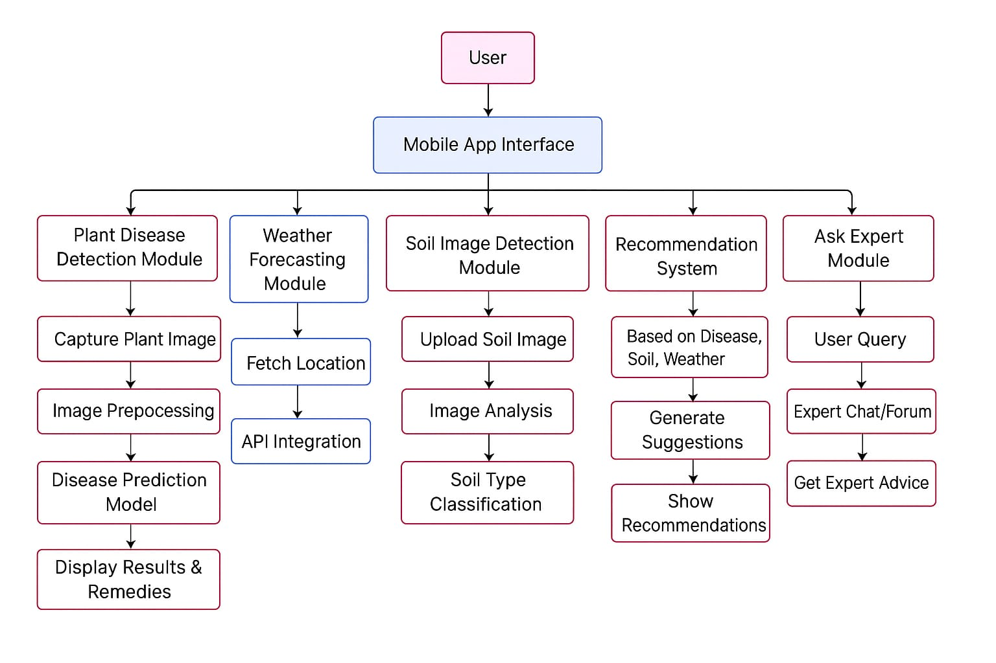
SYSTEM ARCHITECTURE
DD/MM/YYYY

Slide 9
MODULE 1 : Plant Disease Detection Module
Captures and preprocesses images using techniques like resizing, noise reduction, and data augmentation to enhance model input quality.
Utilizes a Convolutional Neural Network (CNN) to classify plant diseases and assess crop health based on image analysis.
Sends diagnosis results and treatment suggestions (e.g., pesticides, fertilizers) to the mobile app for farmer action.
DD/MM/YYYY

Slide 10
MODULE 2 : Weather Forecasting Module
Fetches real-time weather data (temperature, humidity, rainfall) using external APIs such as OpenWeatherMap.
Uses machine learning models trained on historical data to predict upcoming weather patterns and trends.
Displays forecasts in the app to help farmers plan irrigation, pesticide use, and harvesting schedules.
DD/MM/YYYY

Slide 11
MODULE 3 : Mobile App Module
Provides a user-friendly interface for farmers to upload images, receive disease analysis, and view weather updates.
Connects to backend services via APIs to handle data processing, user authentication, and communication with the AI model.
Built with Android Studio, ensuring mobile responsiveness, offline capabilities, and easy access to insights and recommendations.
DD/MM/YYYY

Slide 12
MODULE 4 :The Recommendation System Module
Analyzes disease type, weather conditions, soil/climate data, and historical trends to generate actionable advice.
Recommends pesticides, fertilizers, and irrigation plans tailored to current crop needs and environmental factors.
Powered by AI or rule-based logic to ensure precision, relevance, and adaptability to different farming scenarios.
DD/MM/YYYY

Slide 13
MODULE 5 : Data Storage Module
Stores structured data such as user profiles, captured images, disease results, and recommendation logs securely.
Enables real-time data access and synchronization across modules, supporting analytics and system updates.
Scalable architecture to accommodate future features like crop history tracking, sensor data, and multilingual records.
DD/MM/YYYY

Slide 14
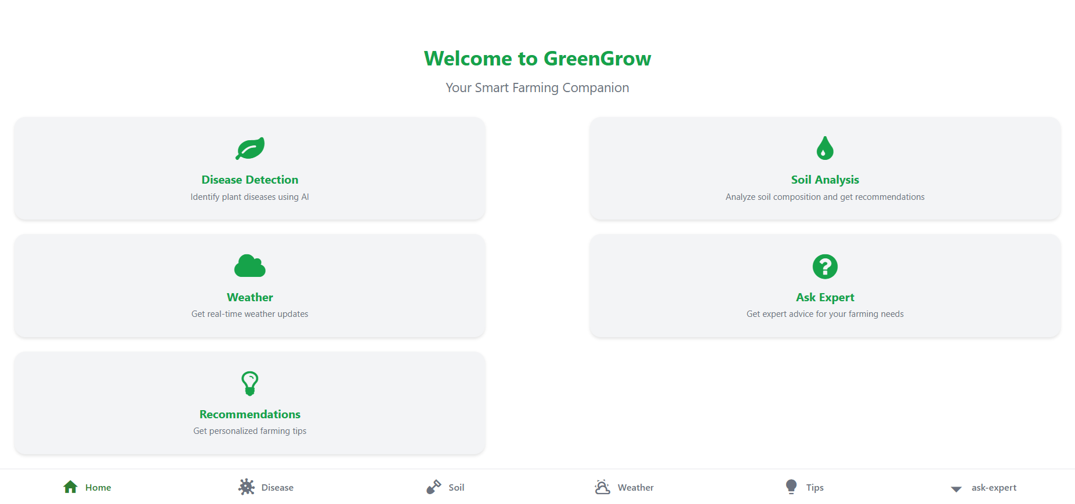
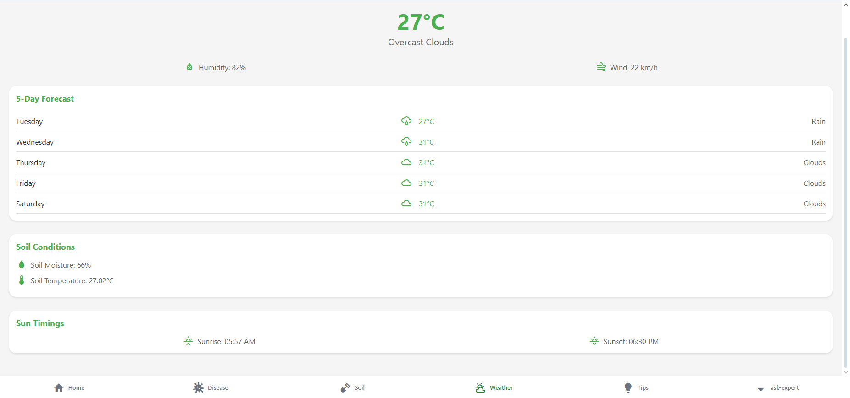
OUTPUT
DD/MM/YYYY

Slide 15
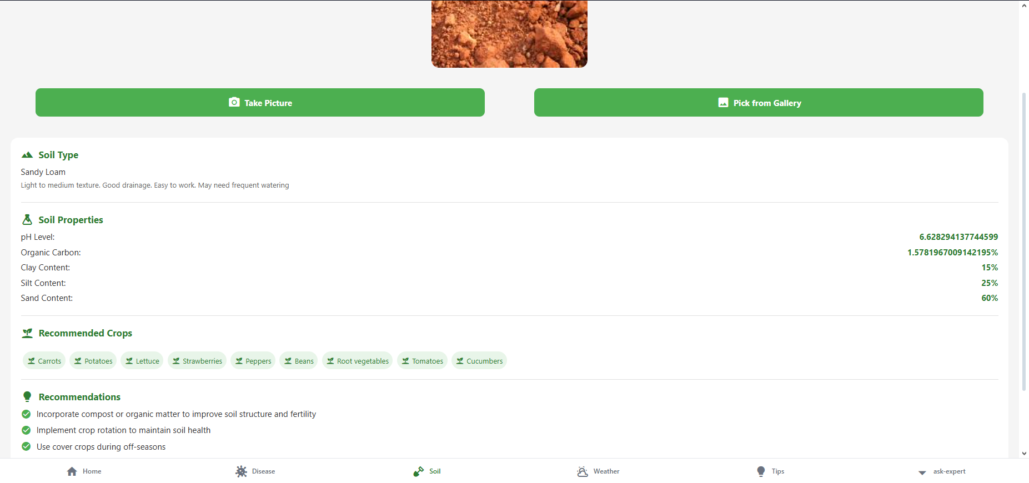
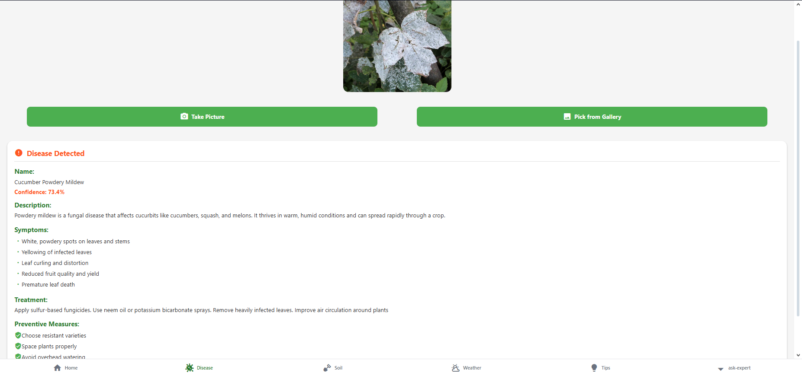
OUTPUT
DD/MM/YYYY

Slide 16
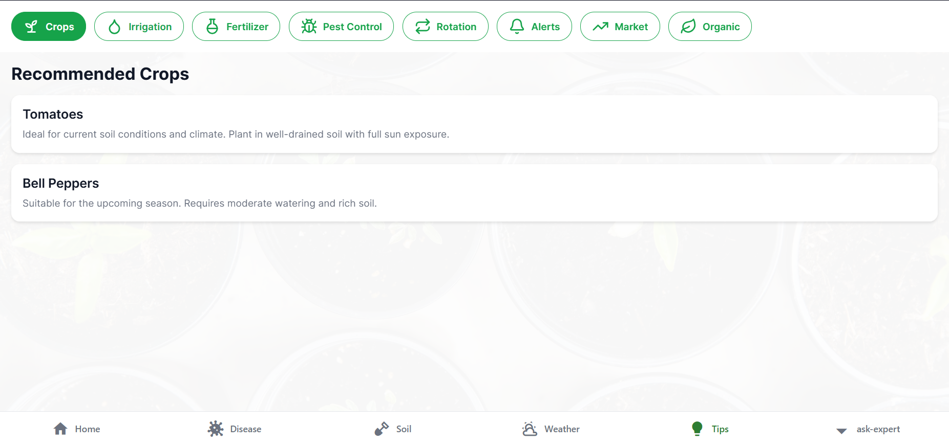
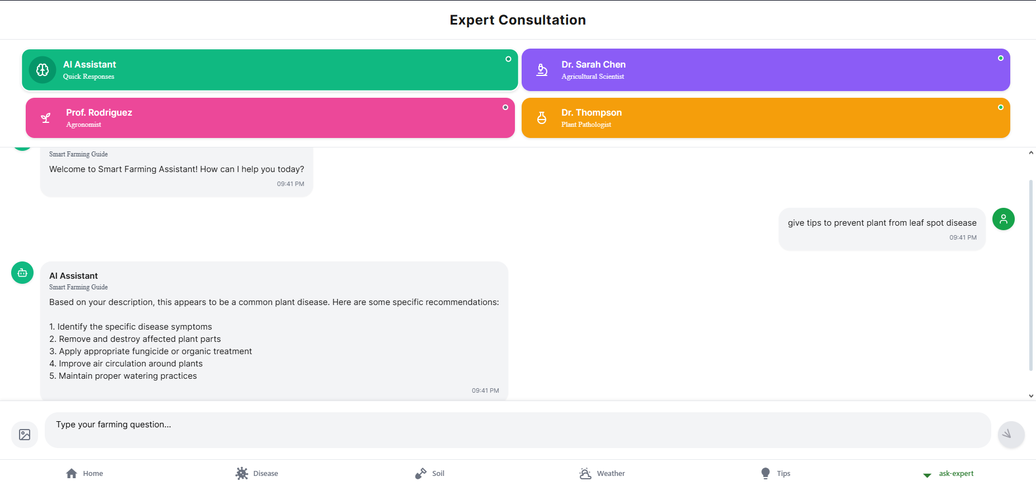
OUTPUT
DD/MM/YYYY

Slide 17
CONCLUSION & FUTURE ENHANCEMENT
. In conclusion, the project successfully developed a smart farming mobile application leveraging AI to assist farmers with soil analysis, plant disease detection, and weather forecasting, promoting sustainable agriculture and improved decision-making through a user-friendly platform.
Multilingual Support: Increase accessibility with multiple languages.
Smart Irrigation Planning: Optimize irrigation schedules using weather and soil data.
Livestock Management Module: Track livestock health and breeding.
Offline Functionality: Enable app use in low-internet areas.
DD/MM/YYYY

Slide 18
REFERENCES
O. Friha, M. A. Ferrag, L. Shu, L. Maglaras, and X. Wang, “Internet of things for the future of smart agriculture: A comprehensive survey of emerging technologies,” IEEE/CAA J. Autom. Sinica, vol. 8, no. 4, pp. 718–752, Apr. 2021.
M. Ayaz, M. Ammad-Uddin, Z. Sharif, A. Mansour, and E. H. M. Aggoune, “Internet-of-things (IoT)-based smart agriculture: Toward making the fields talk,” IEEE Access, vol. 7, pp. 129551–129583, Aug. 2019.
Y. Liu, X. Ma, L. Shu, G. P. Hancke, and A. M. Abu-Mahfouz, “From Industry 4.0 to Agriculture 4.0: Current status, enabling technologies, and research challenges,” IEEE Trans. Ind. Informat., vol. 17, no. 6, pp. 4109–4118, Jun. 2021.
X. Yang, L. Liu, D. Liang, J. Zhang, and Y. Wang, “A survey on smart agriculture: Development modes, technologies, and security and privacy challenges,” IEEE/CAA J. Autom. Sinica, vol. 8, no. 2, pp. 273–302, Feb. 2021.
DD/MM/YYYY

Slide 19

DD/MM/YYYY

